Slide 1
NLP 101
Python Course

Slide 2
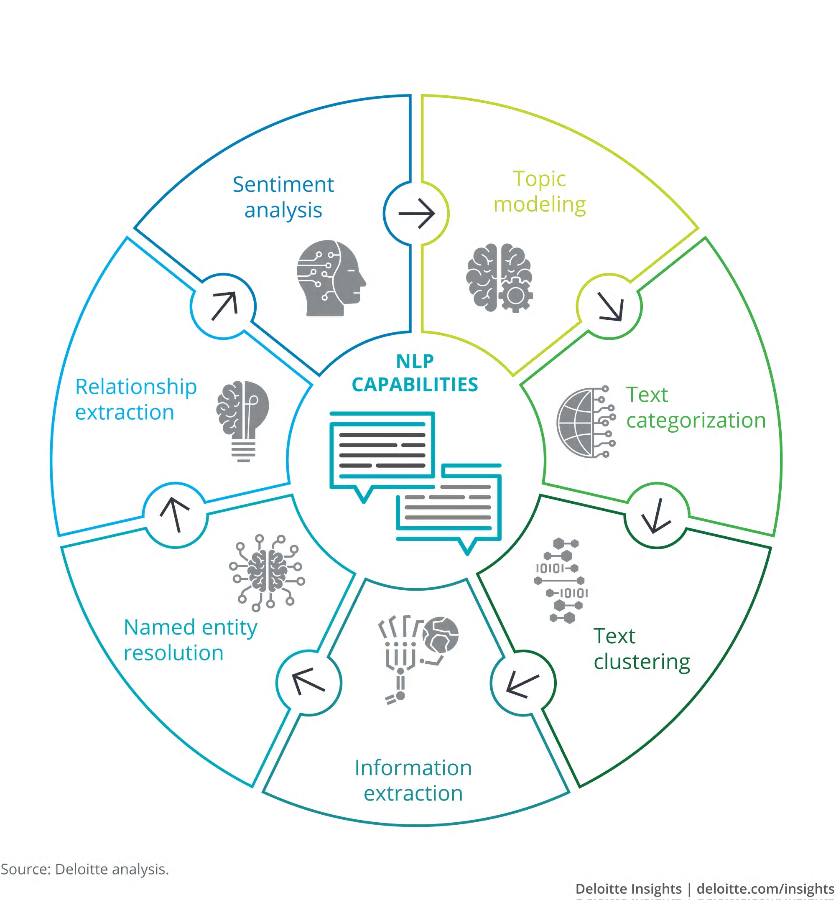
What is NLP?
Natural Language Processing is a branch of artificial intelligence that that helps computers understand, interpret and manipulate human language
Use cases:
Document classification
Spam filters
Sentiment analysis
Document clustering
Information extraction/ data mining
Chatbots/ virtual assistants
Speech recognition
Machine translation
Natural language generation
Question answering
Named entity resolution
Summarization

Slide 3
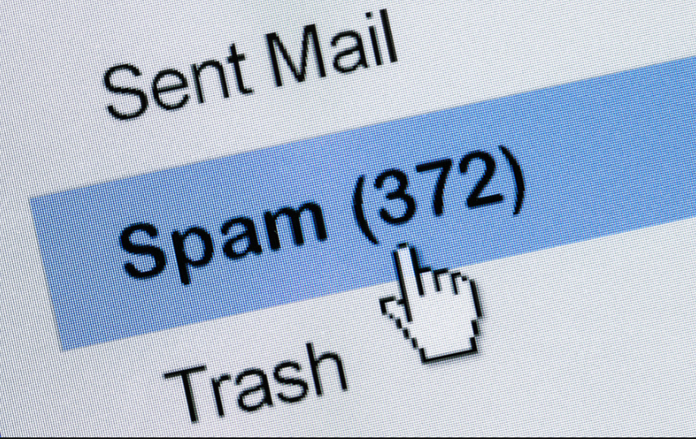

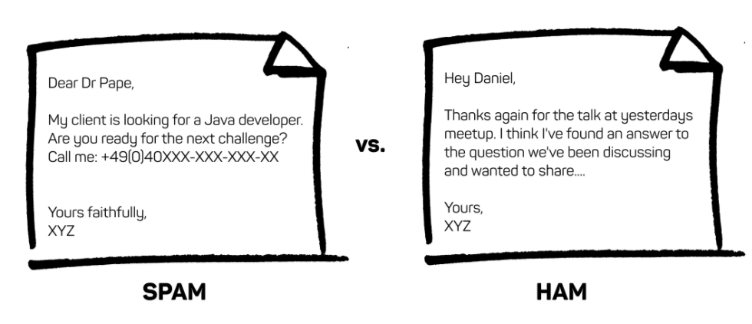
Real World #1: Spam Detector

Slide 4

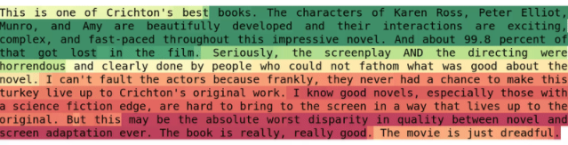
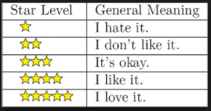
Real World #2: Amazon customer reviews
https://app.monkeylearn.com/main/classifiers/cl_Aiu8dfYF/

Slide 5

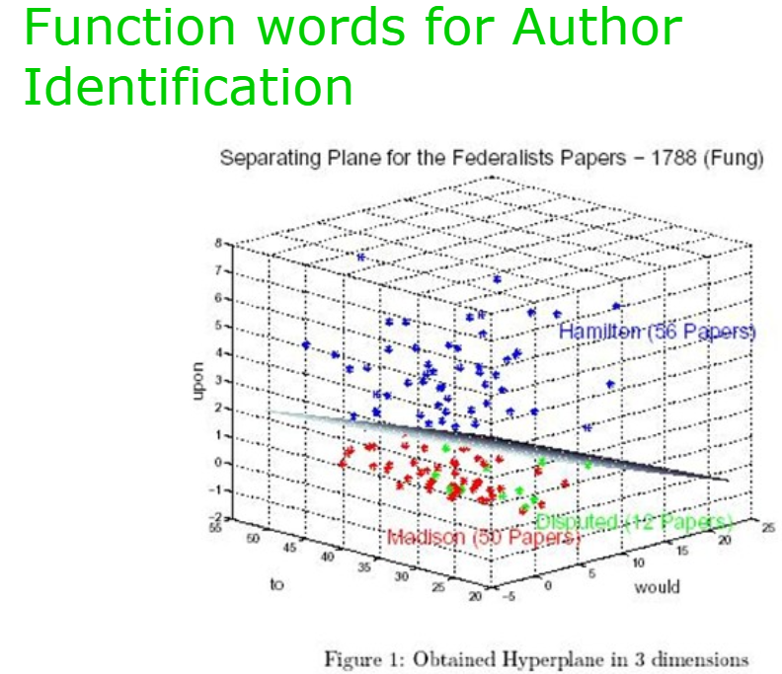
Real World #3: Identifying Federalist paper authors

Slide 6
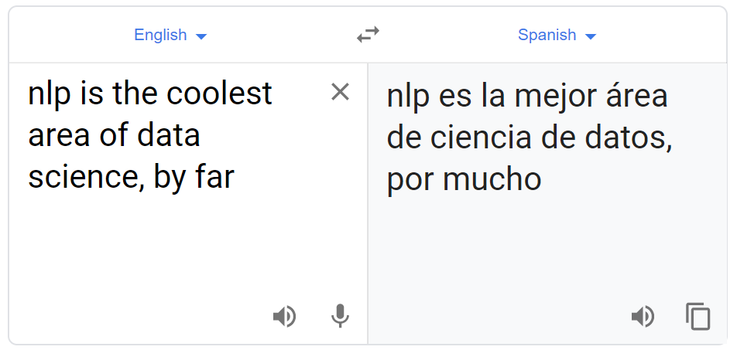
Real World #4: Translation

Slide 7

What makes NLP so difficult?
Data science requires quantitative data; text data is qualitative
Even for a human reader, the underlying concepts, attitudes, and meaning of a text cannot easily be determined
Inconsistent use of language
Misspellings
Slang
Dialects
Punctuation & Other Symbols
Abbreviations
Proper nouns/Capitalization
Grammar – can convey meaning or obscure similarity
Conjugation
Parts of Speech

Slide 8
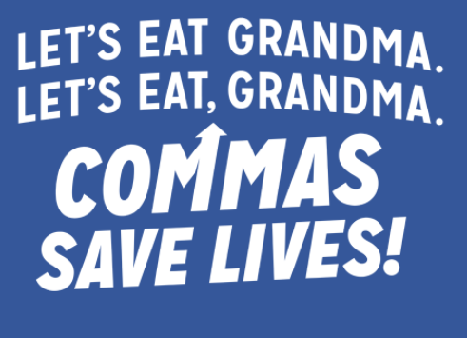

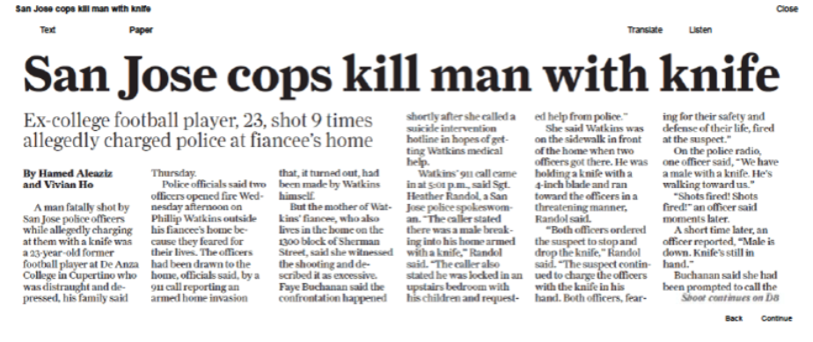
Examples

Slide 9
Text Processing Pipeline
01
Gather and ingest data through text files, Word documents, PDFs, etc.
Extract
02
Perform data cleaning techniques, such as special character removal, stemming, lemmatization, lowercasing, etc.
Pre-process
03
Distill text files to the unit of analysis, most commonly the word or a collection of words (bigrams and trigrams) to prepare the data for transformation into a vector space.
Tokenize
04
Transform the preprocessed/tokenized text into a vector space through a TF-IDF (Term Frequency – Inverse Document Frequency) matrix.
Vectorize
05
Use supervised and unsupervised machine learning algorithms to identify clusters, predict targets or identify relationships between words and/or documents.
Model
06
Present model outputs in a visual format using easy-to-understand graphics and charts.
Visualize

Slide 10
Pre-processing
Lowercase
Number removal
Special character removal
Punctuation removal
Stop Word Removal
Stemming
Lemmatization
Tokenization

Slide 11
Pre-processing 1: Cleaning
White space removal and lowercasing are the two most common, preliminary pre-processing steps that provide text data a more standard form
“ KANYE dropped a new album today, will it be pre or post TLOP quality?” goes to “kanye dropped a new album today, will it be pre or post tlop quality?”
Numbers are typically seen as less useful and additive of noise to text data sets, however depending on the NLP challenge they may be crucial for tasks such as feature engineering
“I made 100 million dollars as an NLP specialist last year” goes to “I made million dollars as an NLP specialist last year”
Special characters are usually defined with the following list, @ # $ % ^ & * ( ) - ~ > < :/ ☹ :<, frequently add noise to text data
“@Wendy’s please bring back the 4 for $4 deal” goes to “Wendy’s please bring back the 4 for 4 deal”
Punctuation is critical to some NLP tasks, such as sentence-level tokenization, but if applied in proper sequence will also remove noise in text
“The quick, brown fox jumped over the lazy dog. What an athlete!” goes to “The quick brown fox jumped over the lazy dog What an athlete”
When should they be kept?
Depending on the NLP task, all of the above may or may not be useful
In general, applying the above pre-processing in a specified order and with varying permutations is important to maintain traceability

Slide 12
Pre-processing 2: Stop Words
Stop words are frequently defined as the most commonly occurring words in a corpus, but may vary in content based on library (spaCy vs. NLTK) or type of corpus.
“Just a small-town girl” goes to “Just small-town girl”
““Livin' in a lonely world” goes to “Livin' lonely world”
“She took the midnight train goin' anywhere” goes to “She took midnight train goin' anywhere”
“Just a city boy” goes to “Just city boy”
“Born and raised in South Detroit” goes to “Born raised South Detroit”
“He took the midnight train goin' anywhere” goes to “He took midnight train goin' anywhere”
When should they be kept?
Depending on the NLP task, stop words may be useful
For example, the translation example previously discussed would necessitate the inclusion of stop words to return a usable result
In general, especially when dealing with large data sets, stop words provide little semantic meaning and should be removed
However, maintaining multiple versions of processed text, including stop word removal and other methods discussed, is best practice to leave room to experiment

Slide 13
Pre-processing 3: Stemming and Lemmatization
Stemming reduces words to roots via the application of a simple algorithm to lop off the beginning or end of a word. Many stemming algorithms exist; a common one is Porter’s algorithm, which consists of 5 sequential phases
“ponies” goes to “poni”
“candy” goes to “candi”
“is” goes to “is”
Lemmatization accounts for grammar and parts of speech, and reduces words to their base forms
“ponies” goes to “pony”
“candy” goes to “candy”
“is” goes to “be”
Which is better?
Lemmatization is more difficult, requiring deeper linguistic knowledge, bigger dictionaries, and more computing time. However, it is more sophisticated and accurate
Stemming is cruder but faster, and may be good enough for your application
You can also apply them sequentially – lemmatize before stemming

Slide 14
Pre-processing 4: Tokenization
Example: “There are many things I know, but I do not know much about NLP.”
Preprocessing
Unigrams
[‘many’, ‘thing’, ‘know’, ‘know’, ‘much’, ‘nlp’]
‘many thing know know much nlp’
‘many thing know know much nlp’
Bigrams
[‘many thing’, ‘thing know’, ‘know know’, ‘know much’, ‘much nlp’]
Trigrams
[‘many thing know’, ‘thing know know’, ‘know know much’, ‘know much nlp’]
‘many thing know know much nlp’

Slide 15
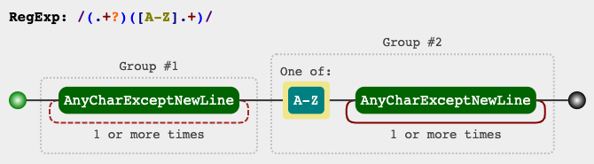
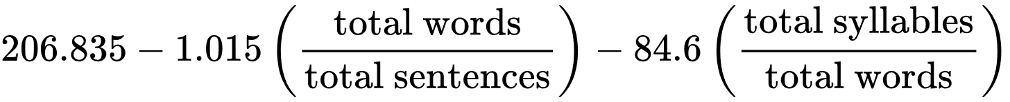
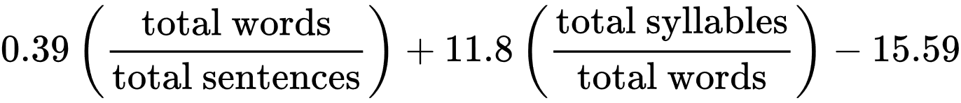
Extracting Features
Features can be extracted from text through the use of regular expressions (regex), a sequence of characters that describe a search pattern.
Very powerful rules-based pattern matching
Not intuitive
Additional features that can be readily generated from text data include:
Word frequency counts
Counting the percent of text that is numeric
Sentiment/Polarity
Subjectivity
Readability Tests
Flesch Reading Ease
Flesch-Kincaid grade level
Extracted features can also be joined with structured data to
create a more robust dataset for machine learning
Flesch Reading Ease
Score | School level | Notes
100.00–90.00 | 5th grade | Very easy to read. Easily understood by an average 11-year-old student.
90.0–80.0 | 6th grade | Easy to read. Conversational English for consumers.
80.0–70.0 | 7th grade | Fairly easy to read.
70.0–60.0 | 8th & 9th grade | Plain English. Easily understood by 13- to 15-year-old students.
60.0–50.0 | 10th to 12th grade | Fairly difficult to read.
50.0–30.0 | College | Difficult to read.
30.0–0.0 | College graduate | Very difficult to read. Best understood by university graduates

